Slide 1
Figures for report
Double strand data

Slide 2
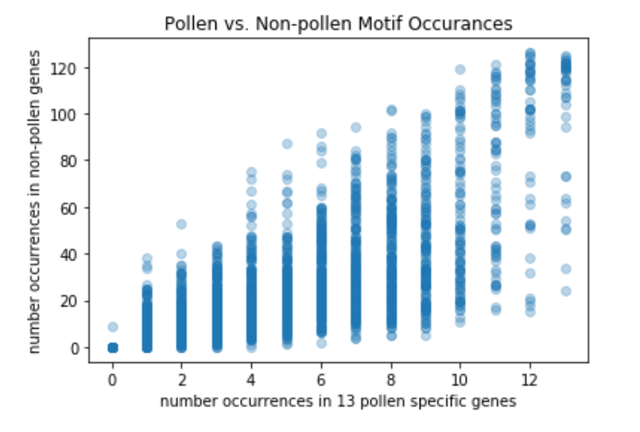
Each point on this scatter plot is one motif. The x-axis and y-axis represent the number of times the motif is found in the pollen specific and non-pollen specific genes respectively.

Slide 3
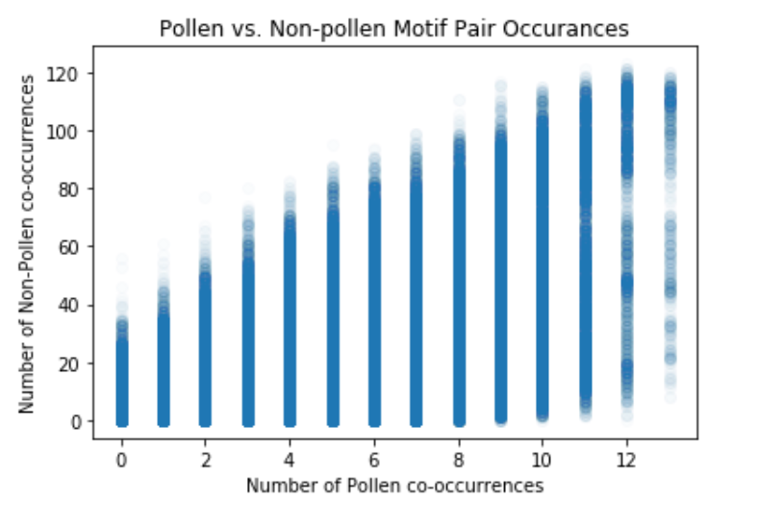
Each point on this scatter plot is a pair of motifs. The x-axis and y-axis represent the number of times the motif pairing is found in the pollen specific and non-pollen specific genes respectively.

Slide 4
true positives | true negatives | Accuracy | Sensitivity | Specificity | motif name
9 | 127 | 0.938 | 0.692 | 0.962 | gimme_15_BioProspector_w10_5
11 | 116 | 0.876 | 0.846 | 0.879 | gimme_143_MEME_4_w12
12 | 114 | 0.869 | 0.923 | 0.864 | gimme_104_Improbizer_GTGCAACGGAGAGT
11 | 115 | 0.869 | 0.846 | 0.871 | gimme_13_BioProspector_w10_3
9 | 117 | 0.869 | 0.692 | 0.886 | gimme_106_Improbizer_AACCATCGTT
10 | 113 | 0.848 | 0.769 | 0.856 | gimme_30_AMD_Motif5
12 | 117 | 0.890 | 0.923 | 0.886 | gimme_132_MEME_3_w10
12 | 112 | 0.855 | 0.923 | 0.848 | gimme_102_Improbizer_GCGTTATACCCGAGGATCAG
9 | 112 | 0.834 | 0.692 | 0.848 | DECOD_Motif5_12
10 | 114 | 0.855 | 0.769 | 0.864 | DECOD_Motif3_12
10 | 116 | 0.869 | 0.769 | 0.879 | DECOD_Motif4_13
9 | 116 | 0.862 | 0.692 | 0.879 | DECOD_Motif5_14
9 | 118 | 0.876 | 0.692 | 0.894 | DME_GMYCTYNGK
9 | 115 | 0.855 | 0.692 | 0.871 | DME_GHTTTASC
9 | 116 | 0.862 | 0.692 | 0.879 | DME_TASGRKYTM
9 | 116 | 0.862 | 0.692 | 0.879 | DME_KAGRYCTKK
9 | 115 | 0.855 | 0.692 | 0.871 | DME_KWAMGMGG
9 | 113 | 0.841 | 0.692 | 0.856 | DME_KGTTGATY
9 | 114 | 0.848 | 0.692 | 0.864 | DME_KGAYCTTG
10 | 112 | 0.841 | 0.769 | 0.848 | DME_RASWGAKCWA
10 | 112 | 0.841 | 0.769 | 0.848 | DME_GRWKGKYGAW
10 | 116 | 0.869 | 0.769 | 0.879 | DME_ARRTCYKVRG
10 | 119 | 0.890 | 0.769 | 0.902 | DME_ACDGWGMYA
9 | 115 | 0.855 | 0.692 | 0.871 | DME_TRSRAWCYC
9 | 124 | 0.917 | 0.692 | 0.939 | DME_WMACGRKKG
9 | 113 | 0.841 | 0.692 | 0.856 | DME_KGVRAGRGS
9 | 115 | 0.855 | 0.692 | 0.871 | DME_YGATSWGT
9 | 113 | 0.841 | 0.692 | 0.856 | DME_DRYGGHTTC
9 | 114 | 0.848 | 0.692 | 0.864 | DME_ARTRARMGG
9 | 115 | 0.855 | 0.692 | 0.871 | DME_AKACKKWGA
9 | 122 | 0.903 | 0.692 | 0.924 | DME_RGCWYAGWK
10 | 112 | 0.841 | 0.769 | 0.848 | DME_MKTHRRGAG
9 | 120 | 0.890 | 0.692 | 0.909 | DME_TGAKYTMCB
10 | 121 | 0.903 | 0.769 | 0.917 | DME_RGRRRYMWGG
9 | 118 | 0.876 | 0.692 | 0.894 | DME_RCRDTGSAA
9 | 122 | 0.903 | 0.692 | 0.924 | DME_ACKKKKGSK
9 | 115 | 0.855 | 0.692 | 0.871 | DME_KCHTTKCRTG
10 | 112 | 0.841 | 0.769 | 0.848 | DME_VASGSARAS
9 | 119 | 0.883 | 0.692 | 0.902 | DME_AGAGKMTSV
9 | 121 | 0.897 | 0.692 | 0.917 | DME_SAKVSTKGA
9 | 124 | 0.917 | 0.692 | 0.939 | DME_AGAGKMTS
9 | 115 | 0.855 | 0.692 | 0.871 | DME_KHGGYTAAR
9 | 117 | 0.869 | 0.692 | 0.886 | DME_CYGRRGMTB
9 | 113 | 0.841 | 0.692 | 0.856 | DME_TCWSGMASWK
10 | 114 | 0.855 | 0.769 | 0.864 | DME_AHGGTGRWR
Metrics for all motifs found in at least 9 pollen genes and no more than 20 non-pollen genes
True positive - number of pollen genes the motif is found in. (out of the 13 identified)
True negative - number of non-pollen genes the motif is not found in. (out of the 145 identified)
Accuracy – (True Positives + True Negatives) / Total number of genes
Sensitivity – Percentage of pollen genes motif is found in
Specificity – Percentage of non-pollen genes motif is found in
Motif Name – The name assigned to the motif

